Slide 1
Activity Recognition using Video Captioning and Summarization
Guide: Dr. Pooja Gupta Assistant Professor
By:
Deepanshi Bansal (35514802715)
Kshitij Gupta (35714802715)
Aayush Gupta (35114802715)

Slide 2
INTRODUCTION
Analysing a video often requires a lot of manual effort and is thus a time-consuming task. A fundamental issue is the understanding of video contents without actually going through the video manually. This is where the concept of video captioning and summarization comes in. It enables one to automatically create captions by recognizing the activities, objects, and locations used in the video. What we get is a condensed description of a video that may then be used for further analysis. Video captioning allows one to measure how content is consumed by the users. Video managers can analyze which terms were frequently clicked on and which section was re visited the most. This data can help benefit future content choices and SEO strategies.

Slide 3

OVERVIEW OF PROJECT
As the technology is improving every day, people are getting more inclined towards its use. The busy schedule of people does not let them spare enough time to watch long videos whether it is related to some cricket match or some teaching or some glimpse of some video. Hence, there is a need to build a system to generate a summary of any video for having approximate glimpse without seeing the video.

Slide 4
DATASET
Two datasets from different sources were utilized for the purpose of this project.
MS-Coco (Common Object in Context) Dataset consists of different images that were used to train the model
SumMe dataset which contains different videos that are relevant for the training and testing purpose using the algorithms to be used further.

Slide 5
CONT…
MS- COCO DATASET
The MS-Coco Dataset is a dataset created by Microsoft which consists of 82,783 images for training purpose and 40,504 images for the testing purpose. There are annotations for all the images and used to find all the possible words in the dataset for the image and build a vocabulary for the model.

Slide 6
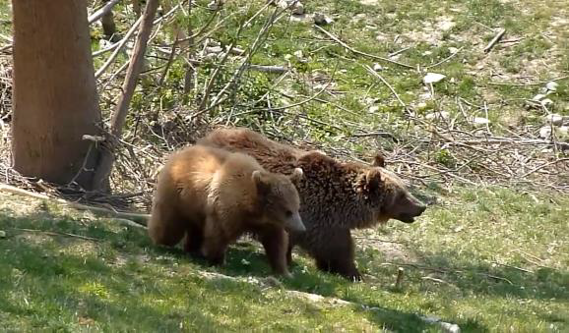
CONT…
SumMe Dataset
The SumMe dataset consists of 25 videos covering holidays, events and sports. They are raw or minimally edited user videos, i.e. they have a high compressibility compared to already edited videos. The length of the videos range from about 1 to 6 minutes.

Slide 7


TECHNOLOGIES USED
Convolutional Neural Networks(CNN)
Recurrent Neural Networks(RNN)

Slide 8
OUR WORK
Our work of video summarization methodology which enables to extract and isolate the different features from any video.
The process starts by doing data preprocessing which includes image resizing and vocabulary building.
Further frame captioning is done which includes training and applying the trained model on the sumMe dataset by dividing the videos into frames.
Further captions of all frames are combined keeping only the meaningful sentences and eliminating the rest.

Slide 9
FLOWCHART
Resizing
Vocabulary Building
Training with Coco dataset
Creating Check Points
Resume Training
Applying Model to the Video Dataset
Text Summarization

Slide 10


RESULTS

Slide 11
FUTURE SCOPE
Audio feature extraction could also be added to the summarized text which could be combined with frame summarized text to produce a better optimized video summarization for practical implementations.
Integration with YouTube know about the video without investing the complete time watching the video.
Summarized text could be useful in recognizing different activities of user in CCTV camera and thus can be used for surveillance for every hour.
Video summarization could be used in sports to get a summarized report of the sports played by the players.

Slide 12
CONCLUSION
The algorithm used for frame captioning for different images worked quite well on testing dataset and on video dataset as well.
Captioning of videos become successful with continuous frame captioning. Summarization of all the frames from each video was done for better and meaningful results.
The preprocessing done before implementation of algorithms was necessary because we needed same embedding matrix size for different frame in videos.
Building of vocabulary was necessary to produce words for captioning model build with LSTM.
 | Training | Testing | Accuracy
COCO Dataset(for Frames) | 82,783 | 40,504 | 86%
Summe Dataset(Videos) | 25 | 7 | 68%

Slide 13
REFERENCES
[1] Baccouche, M., Mamalet, F., Wolf, C., Garcia, C., & Baskurt, A. (2011, November). Sequential Deep Learning for Human Action Recognition. In International Workshop on Human Behavior Understanding (pp. 29-39). Springer Berlin Heidelberg.
[2]Zuxuan Wu (University of Maryland, College Park),Ting Yao (Microsoft Research Asia), Yanwei Fu (Fudan University), Yu-Gang Jiang (Fudan University).Deep Learning for Video Classification and Captioning , Feb 2018
[3] Real-Time Action Detection in Video Surveillance using Sub-Action Descriptor with Multi-CNN by Cheng-Bin Jin*, Shengzhe Li†, and Hakil Kim* *Inha University, Incheon, Korea †Visionin Inc., Incheon, Korea 2017

